Slide 1

Computer Networks Overview, Day 1
Mark Allman
mark.allman@case.edu
EECS 325/425
Fall 2018
“Oh, oh come take my hand,
We’re ridin’ out tonight to case the promise land...”

Slide 2
All material copyright 2011—2018 Mark Allman, All rights reservered.
Acknowledgments:
- Several slides and ideas in this slide set come from Seth Hall.
2

Slide 3
Our Scope
3

Slide 4
Our Scope
This is a class in networking, which is a very broad topic
3

Slide 5
Our Scope
This is a class in networking, which is a very broad topic
We will mostly focus on an artifact: the Internet
3

Slide 6
Our Scope
This is a class in networking, which is a very broad topic
We will mostly focus on an artifact: the Internet
The Internet is not ....
.... the only network
.... the first network
.... some sort of perfect realization of networking theory
3

Slide 7
Our Scope
This is a class in networking, which is a very broad topic
We will mostly focus on an artifact: the Internet
The Internet is not ....
.... the only network
.... the first network
.... some sort of perfect realization of networking theory
The Internet is the most pervasive and successful network
3

Slide 8
What Is The Internet Anyway?!

Slide 9
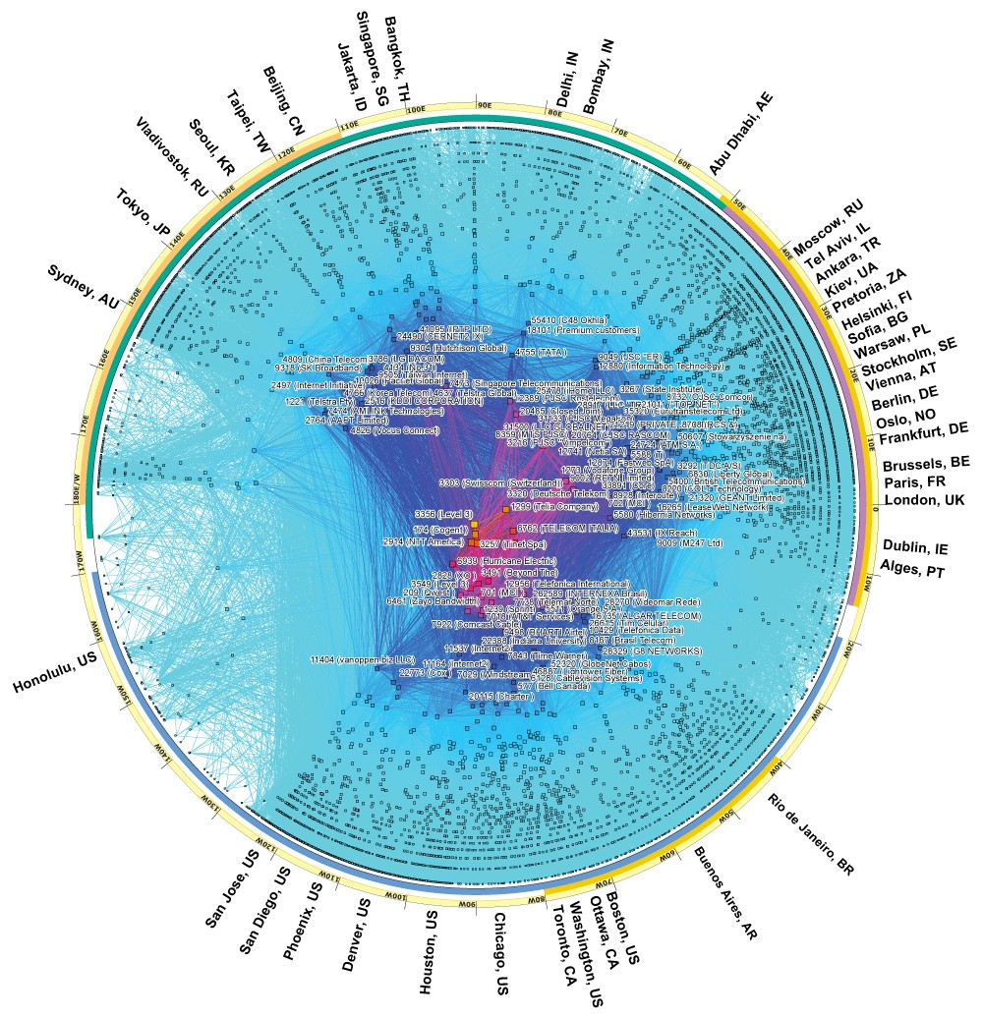
What is the Internet?
CAIDA’s IPv4 AS-level Internet Graph, February 2017

Slide 10
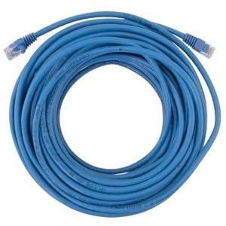
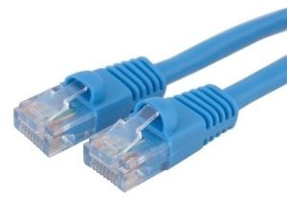
What is the Internet?

Slide 11
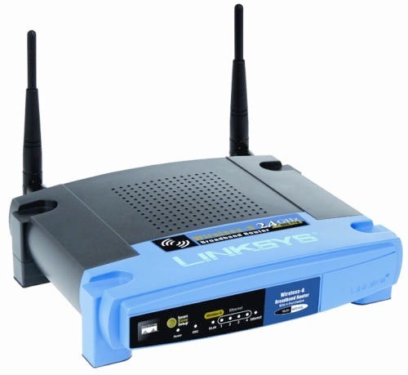
What is the Internet?

Slide 12
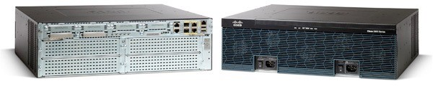
What is the Internet?

Slide 13
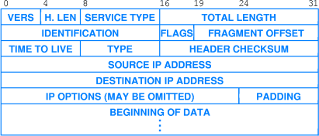
What is the Internet?

Slide 14
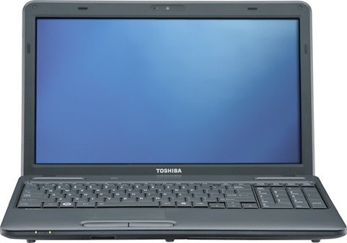
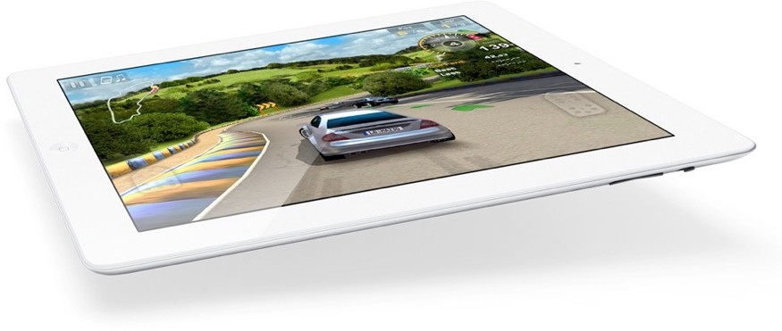
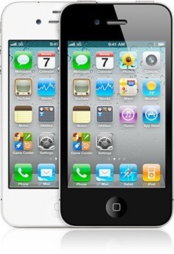
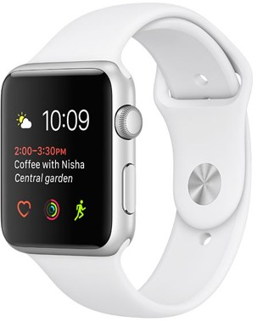
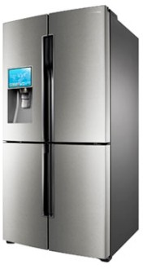
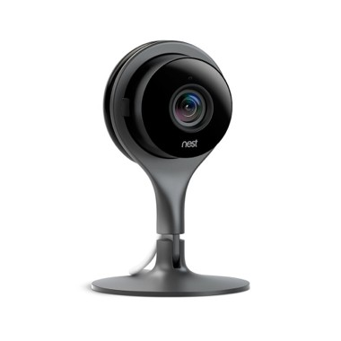
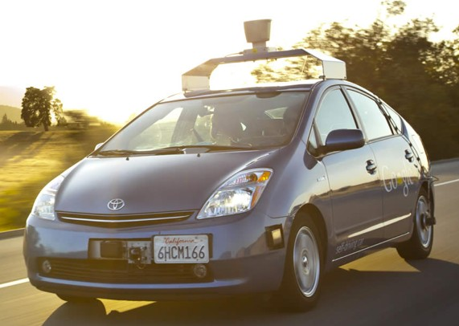
What is the Internet?

Slide 15





What is the Internet?

Slide 16







What is the Internet?
12

Slide 17
What is the Internet?
12

Slide 18









What is the Internet?

Slide 19



What is the Internet?
14

Slide 20



What is the Internet?
14

Slide 21

What is the Internet?
14

Slide 22
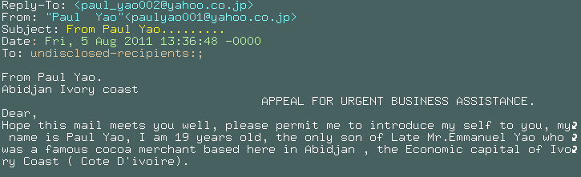
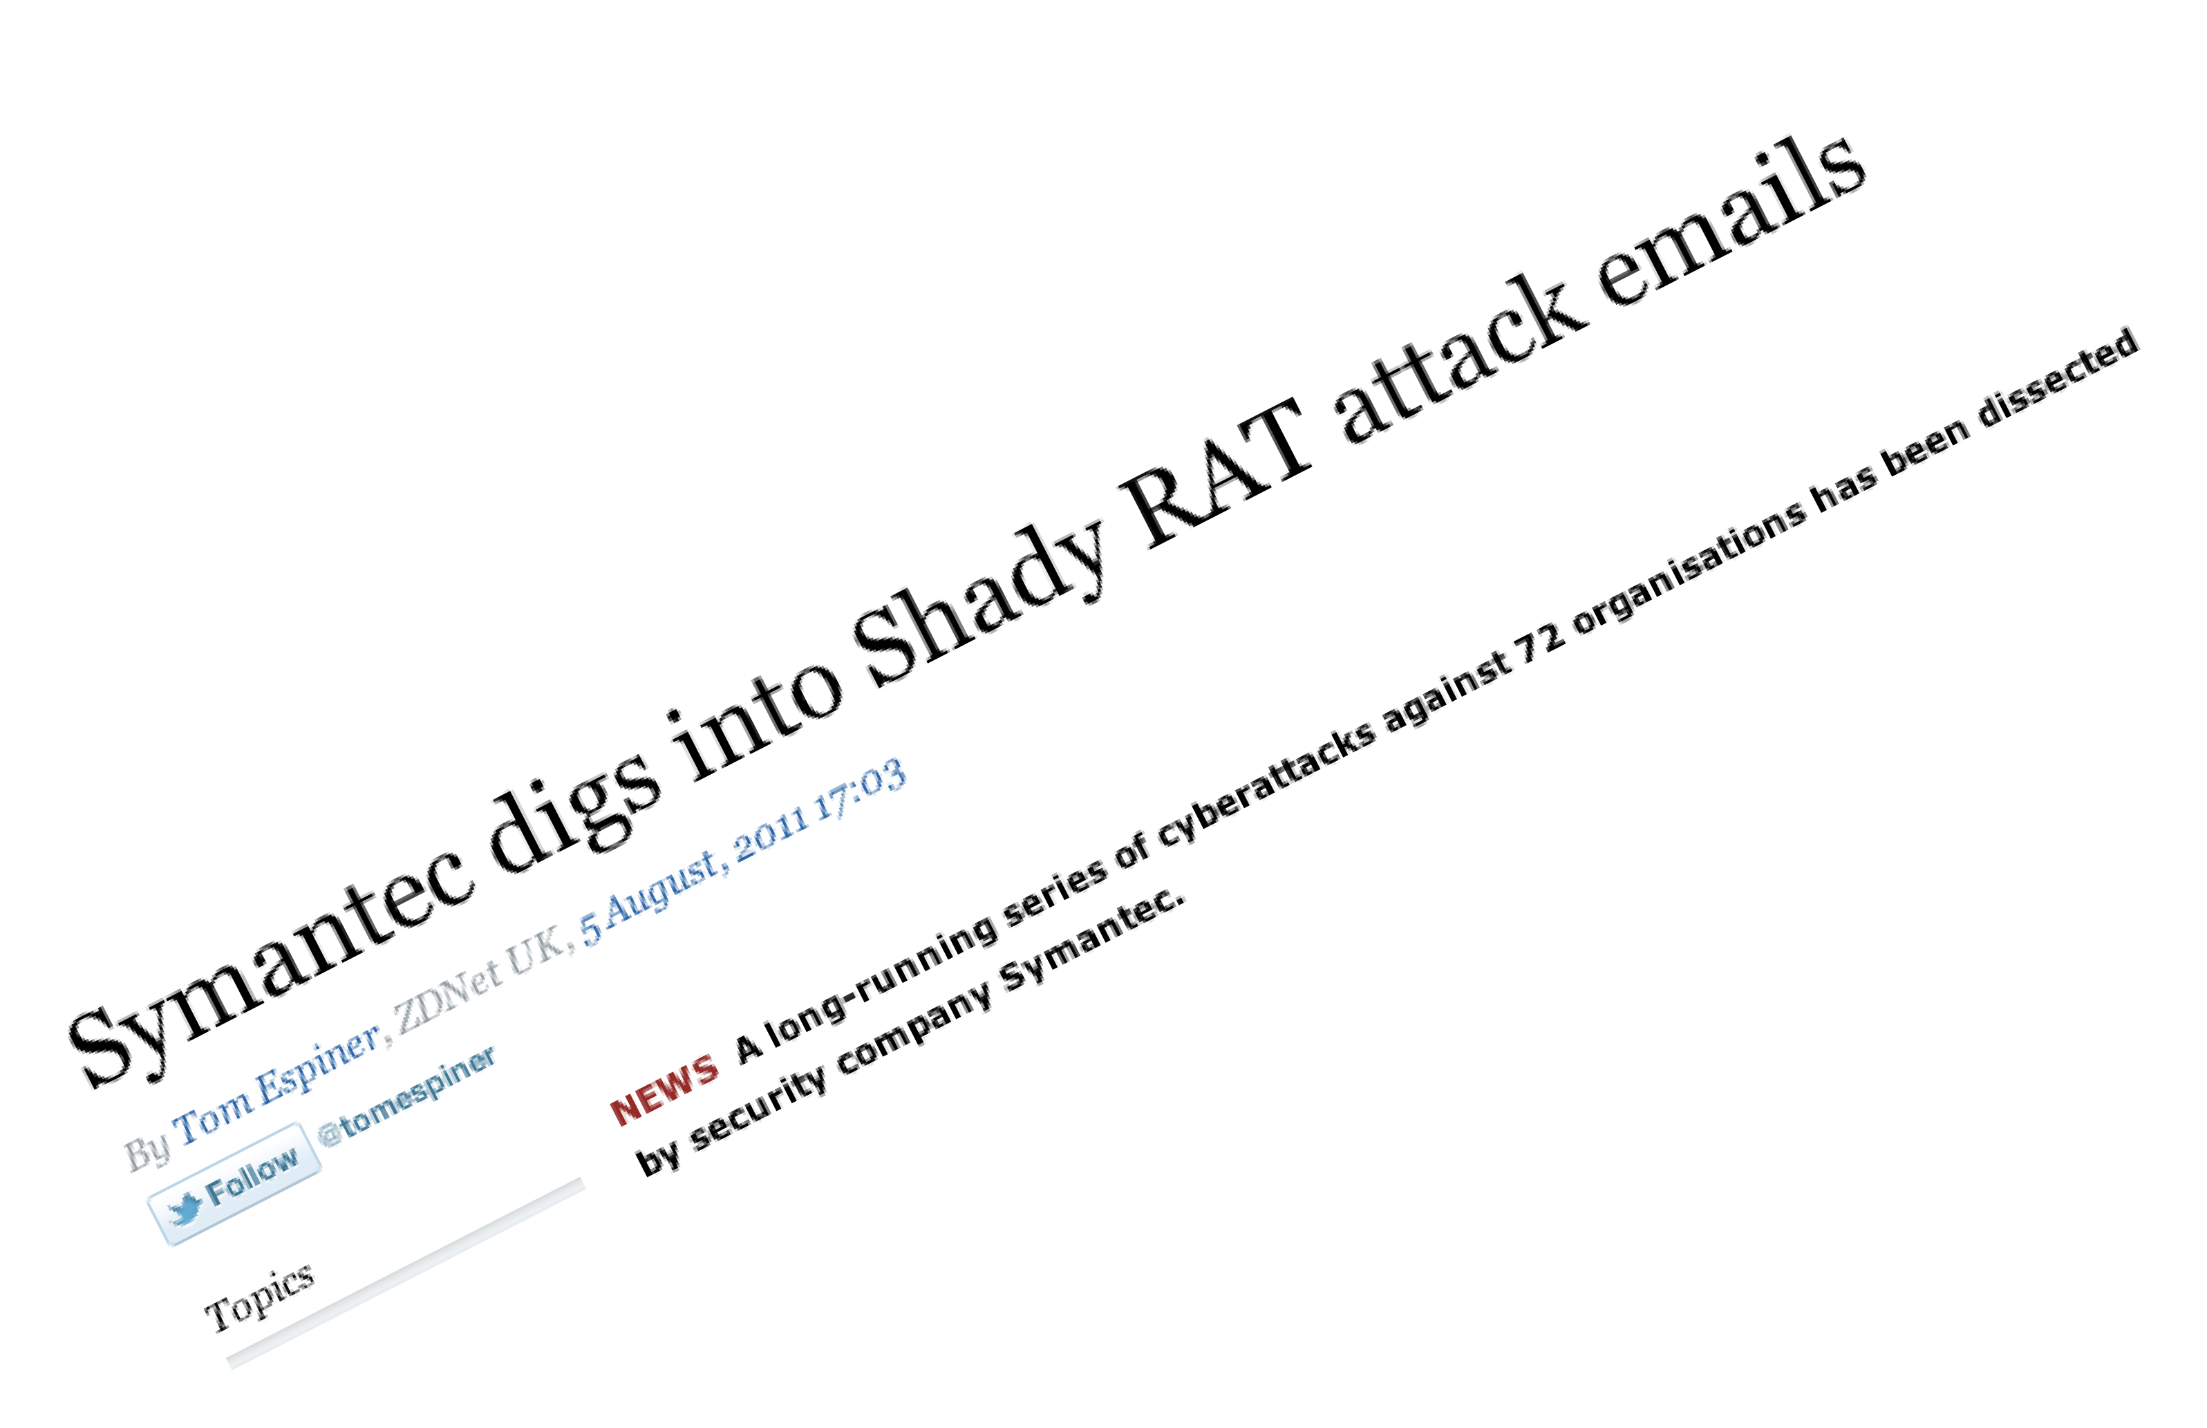
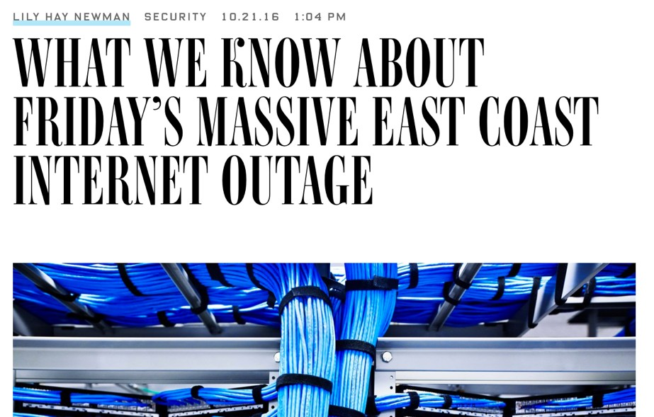
What is the Internet?

Slide 23
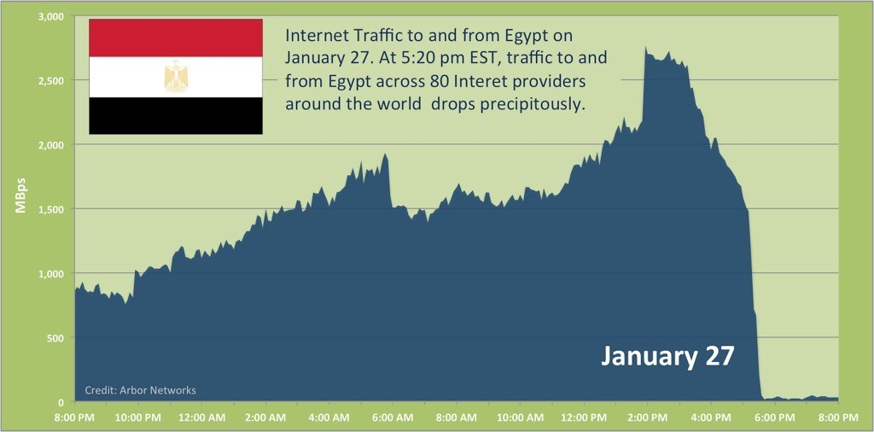
What is the Internet?

Slide 24
What is the Internet?
17

Slide 25

What is the Internet?
17

Slide 26



What is the Internet?
17

Slide 27
Scope Revisited
IP (v4 / v6)
TCP
DNS
BitTorrent
DHCP
NAT
The scope of Internet use is massive
The scope of Internet technologies is massive
We cannot study them all in one semester
End-to-end
principle
Fiber Optics
HTTP
Email
UDP
Late binding

Slide 28
Scope (cont.)
19

Slide 29
Scope (cont.)
Since we cannot cover everything we will focus on two areas.
19

Slide 30
Scope (cont.)
Since we cannot cover everything we will focus on two areas.
Fundamentals:
key abstractions
design criteria
engineering tradeoffs
19

Slide 31
Scope (cont.)
Since we cannot cover everything we will focus on two areas.
Fundamentals:
key abstractions
design criteria
engineering tradeoffs
Exemplars:
particular (common & crucial) protocols and services
e.g., IP,TCP, DNS, HTTP, etc.
19

Slide 32
Scope (cont.)
We will not be studying the nitty gritty of putting together of networks
we will not learn to setup a cable modem
we will not learn to configure a Cisco router
we will not learn to assign static IP addresses to your Windows box
we will not learn how to properly position your wireless access point
we will not write web apps

Slide 33
Scope (cont.)
21

Slide 34
Scope (cont.)
You will end up with a rough understanding about how the Internet works
21

Slide 35
Scope (cont.)
You will end up with a rough understanding about how the Internet works
nobody really understands the entire system
it is the most complex system mankind has ever engineered
21

Slide 36
Scope (cont.)
You will end up with a rough understanding about how the Internet works
nobody really understands the entire system
it is the most complex system mankind has ever engineered
expect me to say “I don’t know” on occasion
or, even on many occasions!
21

Slide 37
Comm. History
22

Slide 38

Comm. History
22

Slide 39

Comm. History (cont.)

Slide 40

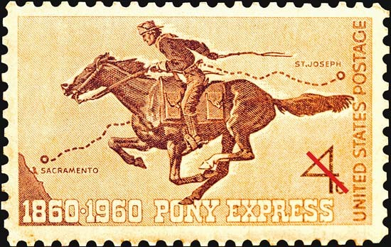
Comm. History (cont.)

Slide 41

Comm. History (cont.)

Slide 42
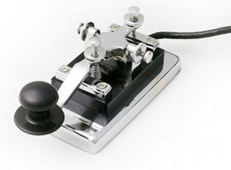
Comm. History (cont.)

Slide 43


Comm. History (cont.)

Slide 44
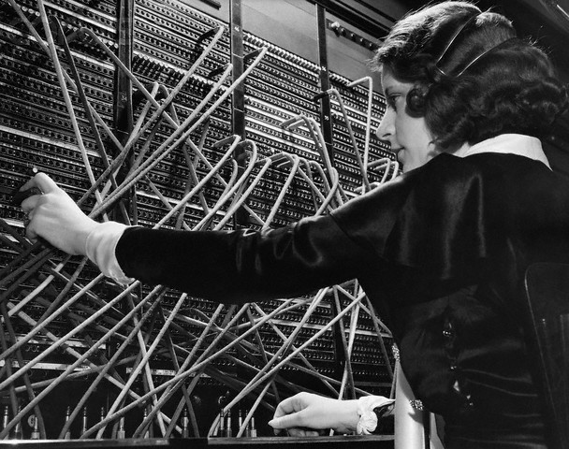
Comm. History (cont.)

Slide 45
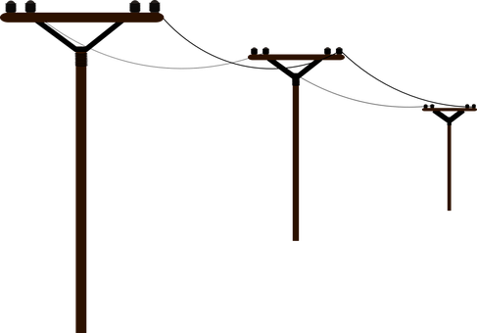
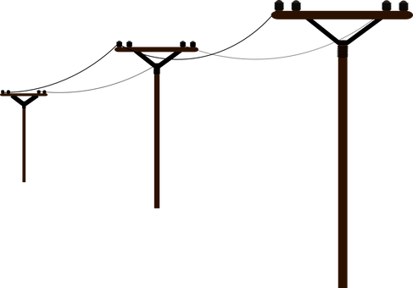




Circuit Switching
Allm
an
29

Slide 46
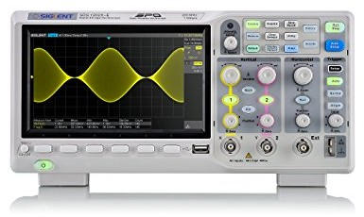
Circuit Switching
Allm
an
29

Slide 47


Circuit Switching

Slide 48
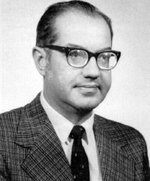
Circuits (cont.)
Paul Baran
31

Slide 49
Circuits (cont.)
Paul Baran
31

Slide 50
Circuits (cont.)
Paul Baran
Ryan
Sarah
Ryan
Sarah
Sarah
Ryan
Sarah
31

Slide 51
Circuits (cont.)
Paul Baran
??
??
??
??
??
Ryan
Sarah
Ryan
Sarah
Sarah
Ryan
Sarah
31

Slide 52
Circuits-vs.-Packets
??
??
??
??
??
Ryan
Sarah
Ryan
Sarah
Sarah
Ryan
Sarah
32

Slide 53
Circuits-vs.-Packets
??
??
??
??
??
Ryan
Sarah
Ryan
Sarah
Sarah
Ryan
Sarah
32

Slide 54
Circuits-vs.-Packets
??
??
??
??
??
Ryan
Sarah
Ryan
Sarah
Sarah
Ryan
Sarah
33

Slide 55
Circuits-vs.-Packets
??
??
??
??
??
Ryan
Sarah
Ryan
Sarah
Sarah
Ryan
Sarah
33

Slide 56
Layering
34

Slide 57
Layering
OSI Model
Application
Presentation
Session
Transport
Network
Data Link
Physical
34

Slide 58
Layering
OSI Model
Internet Model
Application
Presentation
Session
Transport
Network
Data Link
Physical
Application
Transport
Network
Data Link
Physical
34

Slide 59
Layering (cont.)
35

Slide 60
Layering (cont.)
Application
Transport
Network
Data Link
Physical
35

Slide 61
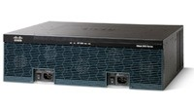
Layering (cont.)
Application
Transport
Network
Data Link
Physical
35

Slide 62
Layering (cont.)
36

Slide 63
Layering (cont.)
Application
Transport
Network
Data Link
Physical
36

Slide 64
Layering (cont.)
Application
Transport
Network
Data Link
Physical
signals
36

Slide 65
Layering (cont.)
Application
Transport
Network
Data Link
Physical
bits
signals
36

Slide 66
Layering (cont.)
Application
Transport
Network
Data Link
Physical
packets
bits signals
36

Slide 67
Layering (cont.)
Application
Transport
Network
Data Link
Physical
packets
packets bits signals
36

Slide 68
Layering (cont.)
Application
Transport
Network
Data Link
Physical
data
packets packets bits signals
36

Slide 69
Layering (cont.)
37

Slide 70
Layering (cont.)
Application
Transport
Network
Data Link
Physical
37

Slide 71
Layering (cont.)
Application
Transport
Network
Data Link
Physical
data
37

Slide 72
Layering (cont.)
Application
Transport
Network
Data Link
Physical
data
packets
37

Slide 73
Layering (cont.)
Application
Transport
Network
Data Link
Physical
data
packets packets
37

Slide 74
Layering (cont.)
Application
Transport
Network
Data Link
Physical
data
packets packets bits
37

Slide 75
Layering (cont.)
Application
Transport
Network
Data Link
Physical
data
packets packets bits signals
37

Slide 76
Layering (cont.)
38

Slide 77
Layering (cont.)
Application
Transport
Network
Data Link
Physical
38

Slide 78
Layering (cont.)
Application
Transport
Network
Data Link
Physical
power, voltages, attenuation, etc.
38

Slide 79
Layering (cont.)
Application
Transport
Network
Data Link
Physical
direct host-
to-host comm (e.g., ethernet)
38

Slide 80
Layering (cont.)
Application
Transport
Network
Data Link
Physical
non-direct host- to-host comm (e.g.,
IP)
38

Slide 81
Layering (cont.)
process-to- process comm (e.g.,
TCP, UDP)
Application
Transport
Network
Data Link
Physical
38

Slide 82
Layering (cont.)
Application
Transport
Network
Data Link
Physical
app-to-app comm (e.g., HTTP, XMPP,
SMTP)
38

Slide 83
Layering (cont.)
39

Slide 84
Layering (cont.)
Application
Transport
Network
Data Link
Physical
39

Slide 85
Layering (cont.)
Application
Transport
Network
Data Link
Physical
} Electrical Engineering (Or, physics!)
39

Slide 86
}
Layering (cont.)
Application
Transport
Network
Data Link
Physical
Computer Science
} Electrical Engineering (Or, physics!)
39

Slide 87
}
Layering (cont.)
Application
Transport
Network
Data Link
Physical
Computer Science
} Computer Engineering
} Electrical Engineering (Or, physics!)
39

Slide 88
Layering (cont.)
40

Slide 89
Layering (cont.)
Application
Transport
Network
Data Link
Physical
40

Slide 90
Layering (cont.)
Religion
Politics
Money
Application
Transport
Network
Data Link
Physical
40

